Slide 1
Romania - Sibiu Rural Area
In the center of Romania, Inside the Carpatians Arch, Hilly and montan relief, Silvo-stepa 60% forests, Temperat Continental Climate;
Accessibility:
- Airport Sibiu and Targu Mures
- Railway infrastructure
- National Roads infrastructure & in future two auto roads will be built
Economic dynamics – Sibiu industrial area;
Agriculture - Arable areas with black earth, rich in humus, suitable for Eco Agriculture
Harmonious Cultural & Religious diversity:
Small traditional towns and villages with Romanian & German old
architecture,
Traditional lifestyle and various intangible heritage
Folk customs, dances & clothes,
Handicrafts – in wood, iron, glass, pottery
Transhumance & Culinary traditional customs
Orthodox, Catholic, Lutheran and Evanghelic Churches

Slide 2
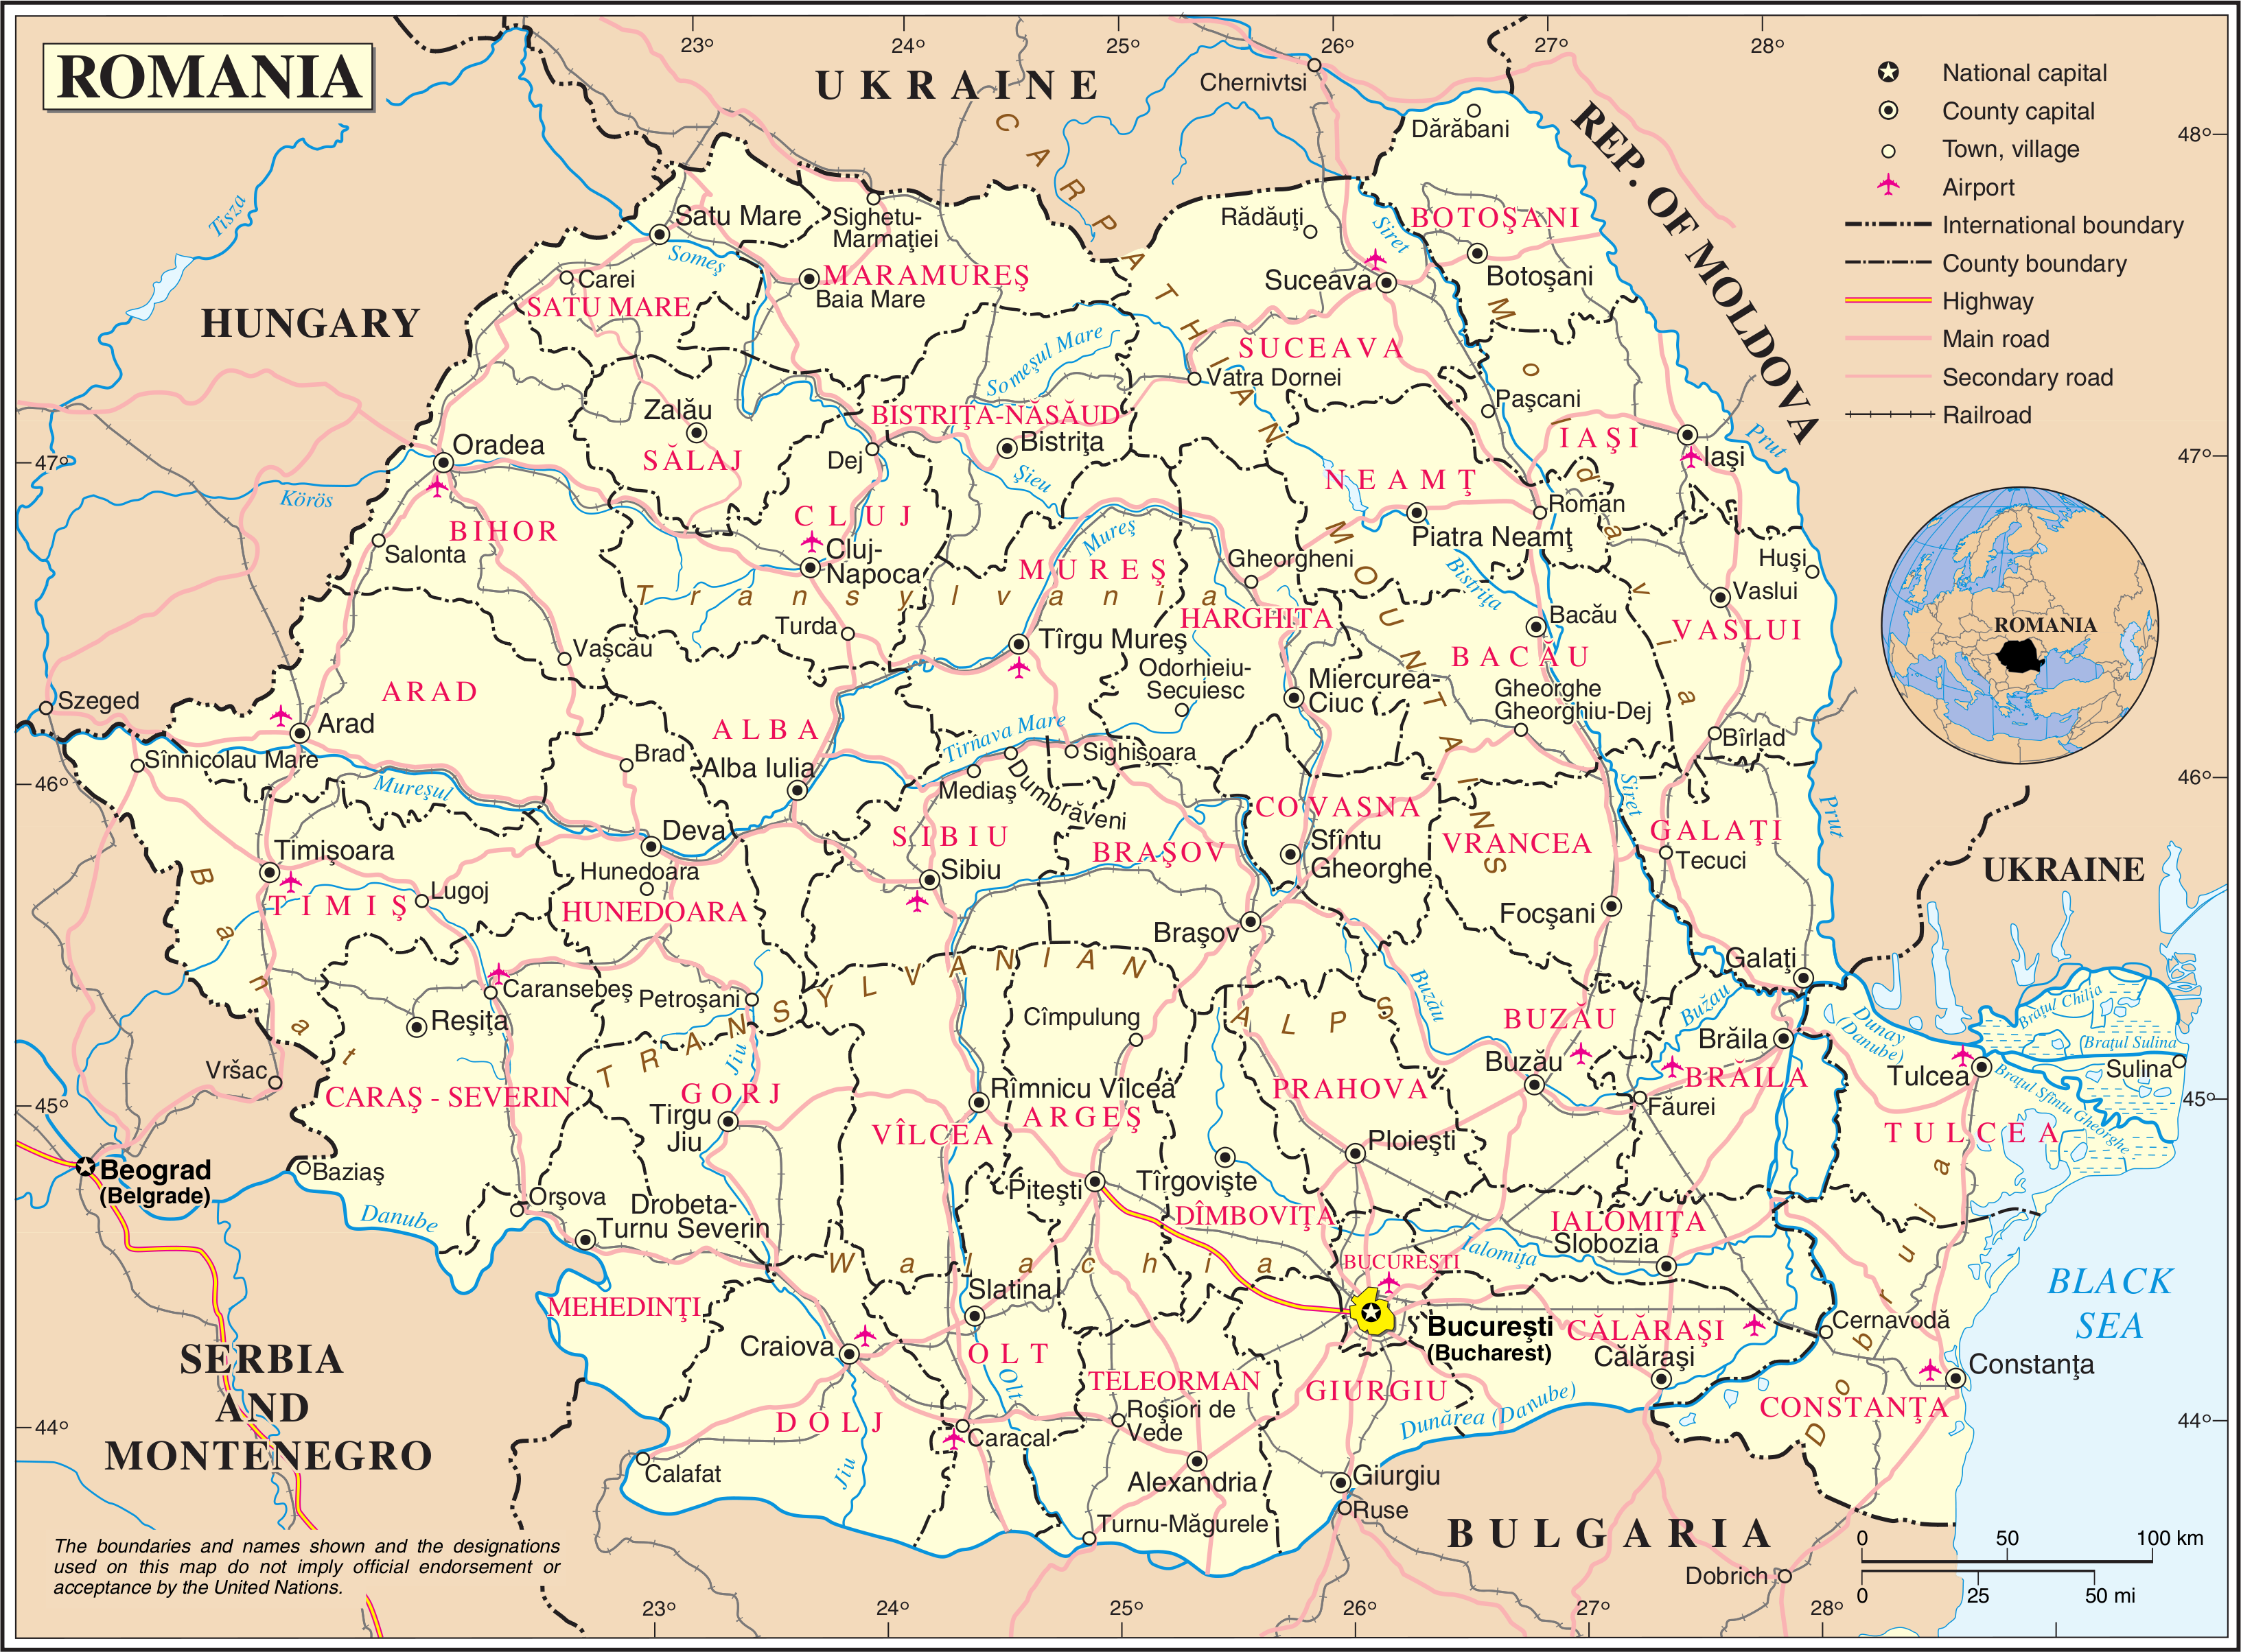
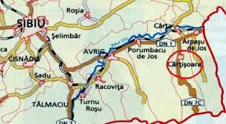

Slide 3
Romania - Sibiu Rural Area
Sibiu Town – EU Cultural Metropolis in 2007
www.sibiu.ro
Fagaras Mountains (2541 m):
Climbing, Hinking, Mountaineering
http://www.summitpost.org/f-g-ra-mountains/154116
http://www.welcometoromania.ro/DN7c/DN7c_Lacul_Balea_r.htm
Transfagarasan Road:
2011 Top Gear's best road in the world
Connects the historical Romanian Regions Muntenia and Transilvania, acoross the Fagaras Mountains at 2042 m
http://www.youtube.com/watch?v=XwMEX0jgPxE
National parks and reservations

Slide 4
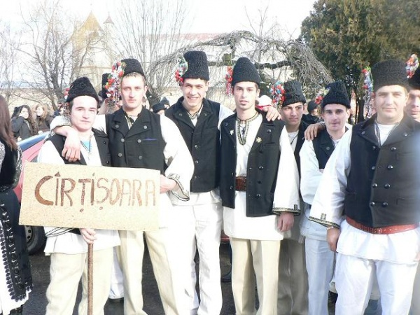
Sibiu Rural Area - Cartisoara Village
In 2012, Cartisoara Village was included in the Official guide of “The most beautiful villages in Romania ”

Slide 5
Sibiu Rural Area - Cartisoara Village
Opportunities for a healthy enjoyable holiday:
Agrotourism – more than 20 farm & guest houses
Festivals – traditional costumes, songs & dances
Healthy & Eco lifestyle, food and life
Variety of recreational activities - fishing, hiking, biking
Direct access to mountain trips
Still wild area in the proximity of the village
Advantages
Is the first village placed on the Transfagarasan Road
Distances: 50 km from Sibiu
National Road & Railway transport available
History: Since 1223
Romanian Traditional Architecture
Proximity to Mountains, National Reservations, Trout Farms, Agricultural & Manufacturing

Slide 6
Sibiu Rural Area - Cartisoara Village Project ideas
Vital Theme: Profiling and Branding
Create and promote a profile and a brand of the area and its identity key qualities and opportunities offered
Create a rural network society oriented both inside the area and also to similar areas in other countries for digital promotion and inform
Organize communication campaigns inside and outside the area
Exchange experiences on local lifestyle
Vital Theme: Wellbeing and Lifestyle
Learn how to return to live in simple, healthy and traditional way
Healthy Agriculture
Exchange and promotion of local traditional culture
Exchange experiences on local lifestyle
Increase awareness of the local people for a healthy lifestyle

Slide 7
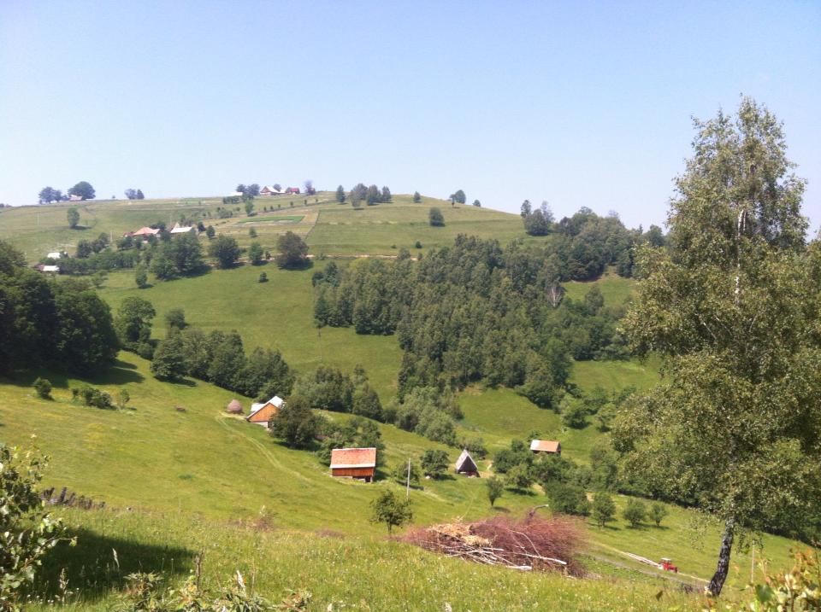
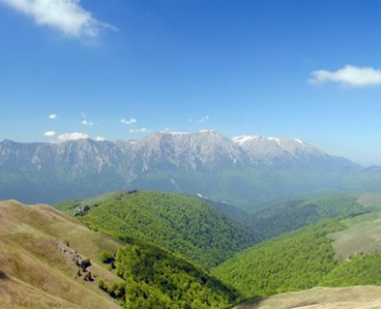
R O M A N I A Sibiu Rural Area Cartisoara Village
T h a n k y o u !
Gabriela CODREA
+40 722 145 004
codreagabriela@yahoo.com

